Slide 1


arkingBot
2018 亞洲跨國 Hackathon － 觀光旅遊
Notes:
Hello everyone we are 3drens.

Slide 2
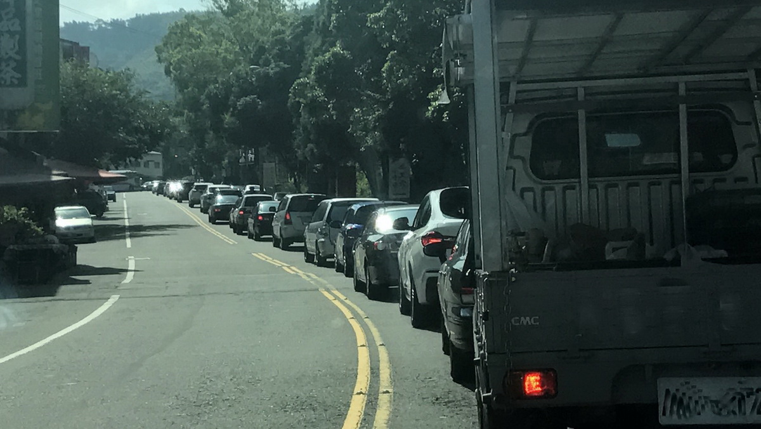
Notes:
I think most of you have the experience this situation in your journey? Waiting for a long traffic jam just for one precious parking lot.

Slide 3
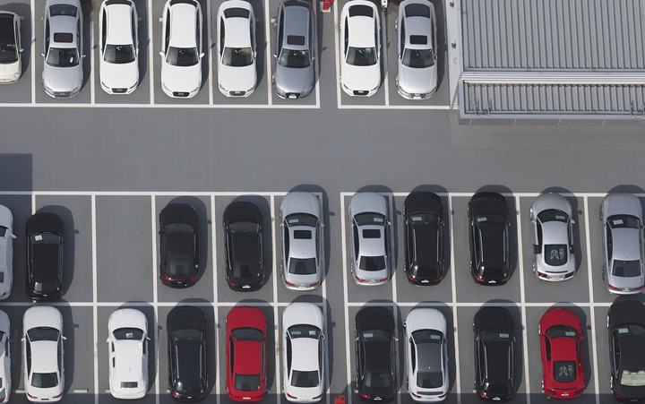
Finding a parking lot is a headache issue.
Notes:
Finding a parking lot is always headache issue of every driver.

Slide 4
336 hours
to find parking space per year
30%
of traffic congestion
100%
driver had cancelled trip due to without parking lot avail.
Ref: (Association for European Transport 2006)“A Survey of Smart Parking Solutions”, 2017,IEEE Press
Notes:
According to report driver average spend 336 hours to find parking space per year
And this effect the 30% traffic jam.
Most of drivers have the experienced of cancelled the trip or change destination just because of no parking lot.

Slide 5

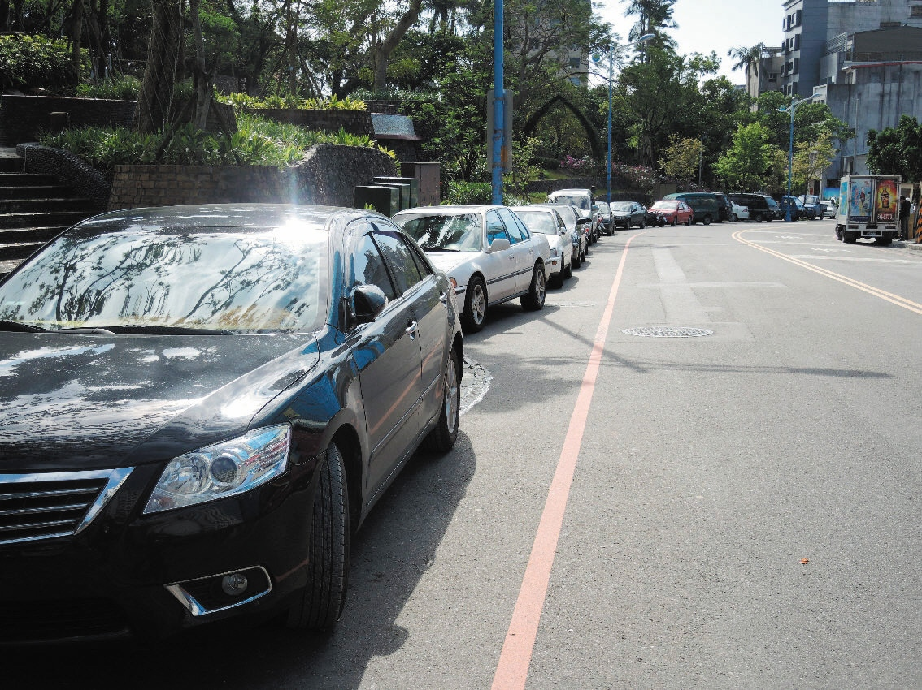
Bad travel experienced.
Top 1 traffic issue in Taipei
illegal parking
47.4% of
traffic tickets.
Notes:
It not only effect your travel experience and also cause a city wide issues, In taipei city , almost half traffic tickets are come from illegal parking, it become the top one traffic issue.

Slide 6


It’s not only about “lack of parking space” but “where it is”.
Notes:
But most of driver blame it to not enuf of parking lot, but the problem is the real time parking information is not deliver to themselves.

Slide 7
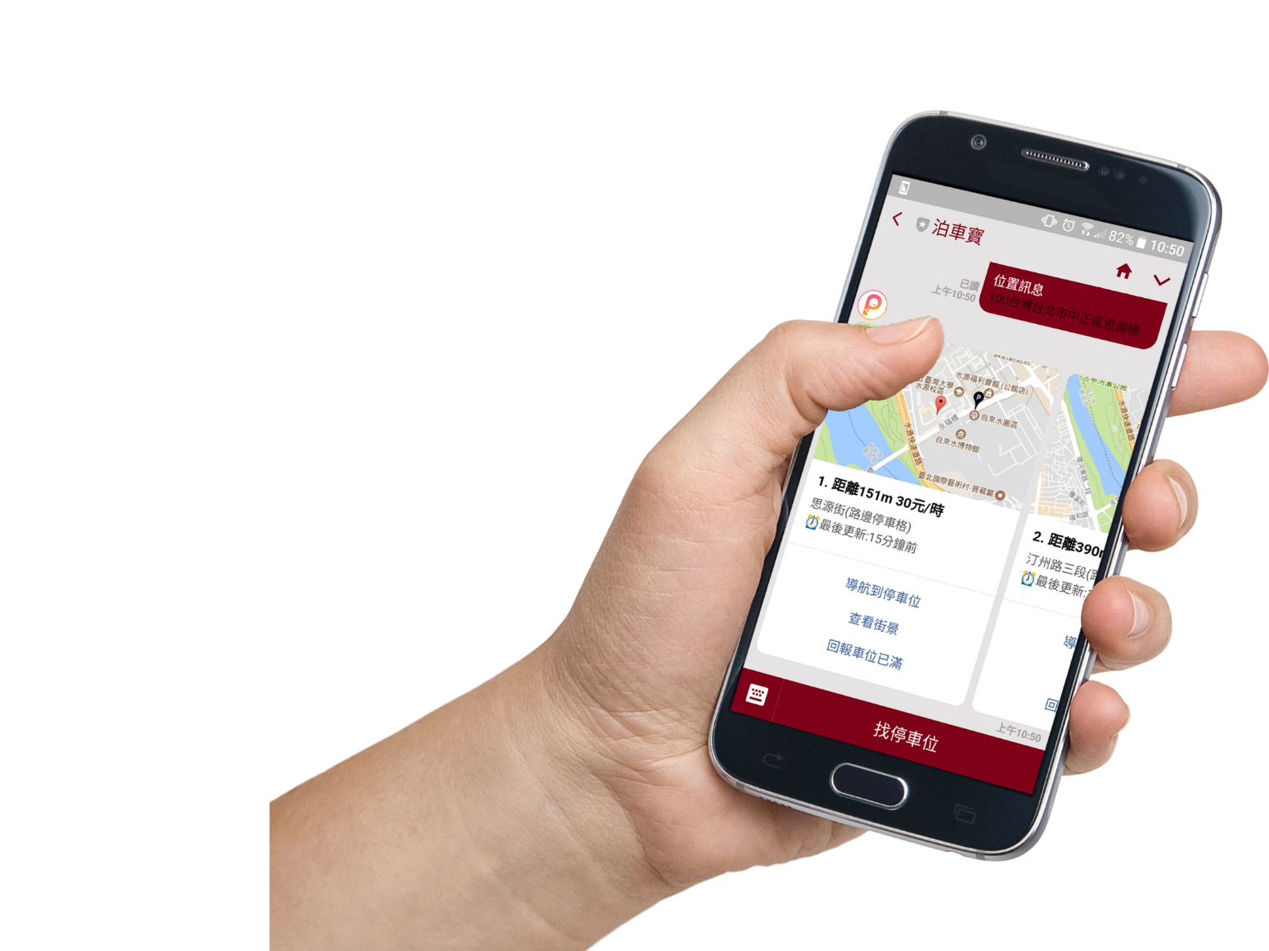

arkingBot
Navigate to parking lot
Street view
Crowd information
Unpaid fees inquiry
Notes:
So we are here to solve this problem, introducing the parking bot, we provide 2 features , first we

Slide 8

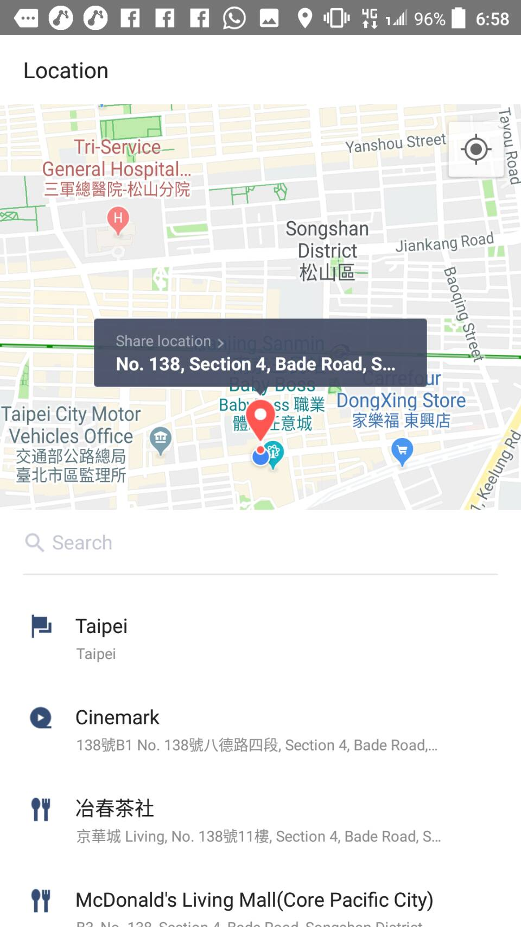
1
Share your position
Notes:
First of all, share your location to line bot.

Slide 9
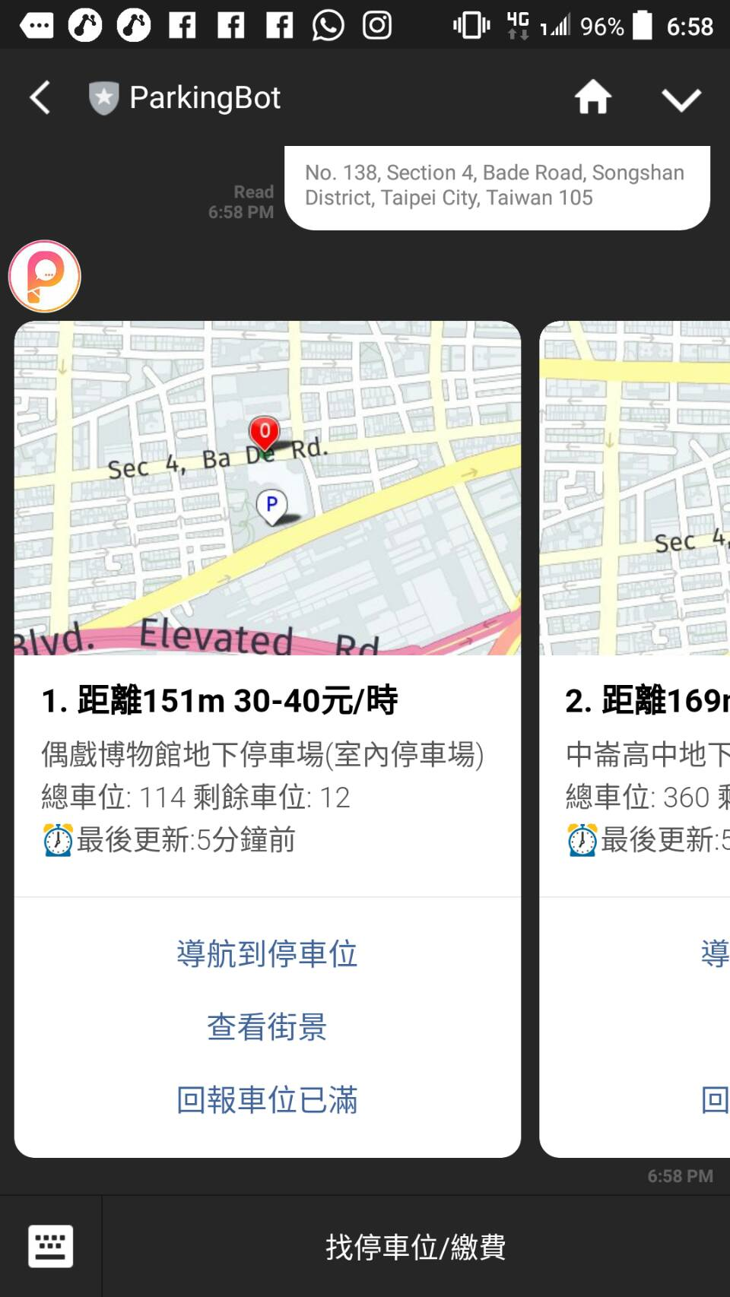
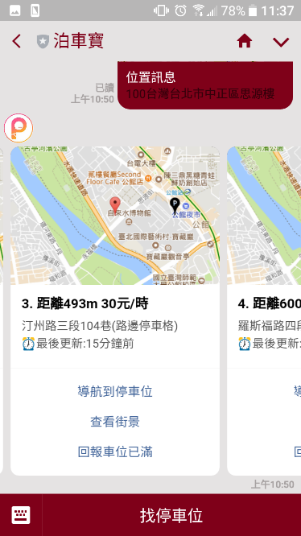

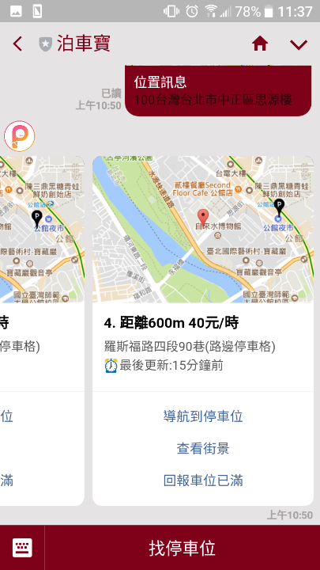
2
Select desired parking card
Notes:
Parking bot will return the nearest parking lot with represent as card, you can swipe and choose where u want to park.

Slide 10
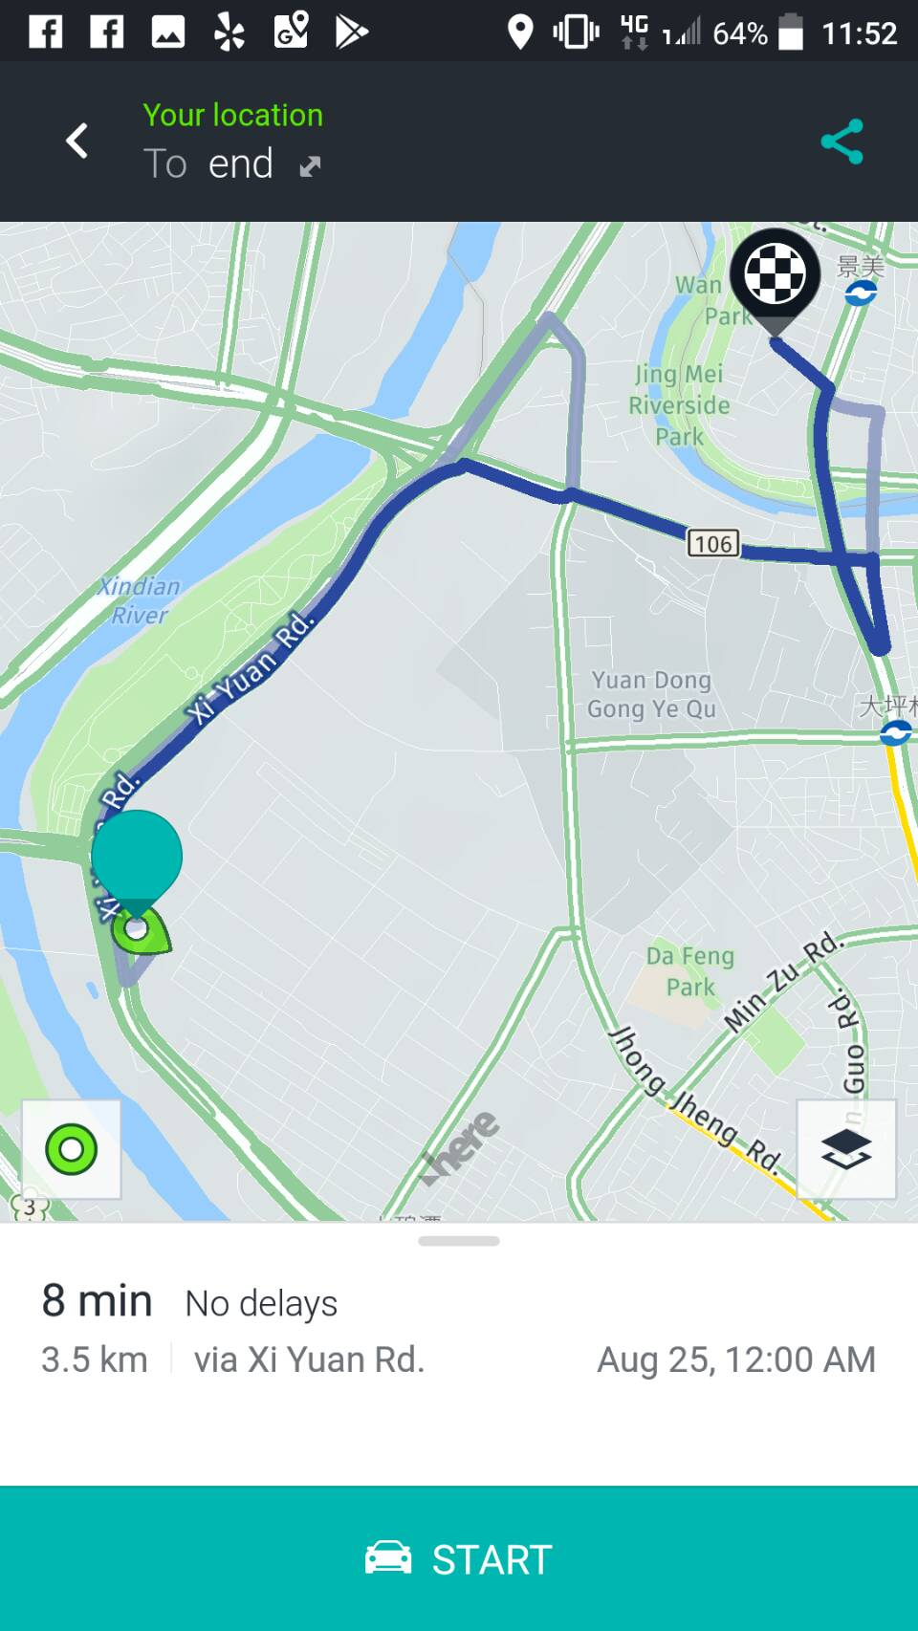
GO
Navigation and GO!
Notes:
And that‘s it , just go parking with navigation! And is it easy , would u like to try ?

Slide 11



How it works?
more
Real-time Parking
information (open data)
Process and re-format
Feed to Line messenger
Notes:
How it works ? We collect all real time parking data, process and reformat them and feed them to line messenger .

Slide 12




Scoring system
Compute Engine
User location
Occupancy prediction
Parking lot distance
Usage (space availability)
Route matrices
Traffic condition
Weather (Shower/Sprinkles)
User input
Optimize parking
possibility.
Notes:
In order to ensure every driver has opportunity to parking, we design the scoring system, we calculate the occupancy prediction by distance, space availabilty, and thanks to here map they provide rich of api like route matrice, traffic condition and weather, these useful information will help us to optimize parking posibility .

Slide 13

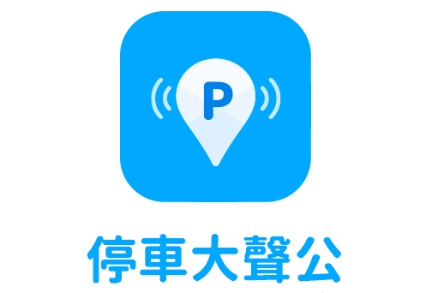




Other parking Apps are good, but we more focus on messenger app.
wide
< 3 second to get parking
Parking lot data coverage
in Taiwan
narrow
User operation time
slow
fast
Notes:
Comparing to the other parking application, these application are good, but parking bot is more focus on driver safety, we eliminate the unnecessary operation process and shrink the user operation time. Only 3 second to get the parking.

Slide 14




Why we choose LINE rather than Apps?
Apps
Growth of Apps usage in only 1%
LINE MAU 19 Million
1. “2017 App Key report”, Flurry 2017.
2. Techcrunch: Majority of U.S. consumers still download zero apps per month, says comScore, 2017.
3. LINE 2018年度記者會, 2018/3/9.
Notes:
Why we choose line messenger rather than mobile apps , according to report, the growth of app install and usage has decrease to 1% , but the line messenger is popular messenger between Korea, Japan and Taiwan, there is about 19Mil active user in taiwan, so we decided choose implement our application on line.

Slide 15


Supported parking information from open data.
Street parking lot
Indoor parking lot
Street parking lot
Indoor parking lot
S. Korea Indoor parking lot
> 10,000 parking information!
Notes:
Currently in this MVP level project, the parking open data has supported in taipei / new taipei city and S korea .

Slide 16
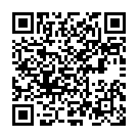

Thanks you, 3drens need your support!
ParkingBot
1scan
2steps
3go to parking !
Notes:
Please join us and enjoy the new parking experience with parking bot. one scan two steps three go to parking.

